Slide 1
Embedded C program for interfacing a 7-segment LED with increment switch

Slide 2
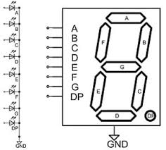
Algorithm
Read the status of the switch.
If the status of switch is changed, increment the count on seven segment display.
There are 2 types of 7 segment LED’s, here we are using common Cathode type

Slide 3
Defining combinations of ABCDEFG for different integers.
Integer | a | b | c | d | e | f | g | Hex (abcdefg)
0 | 1 | 1 | 1 | 1 | 1 | 1 | 0 | 0x3F
1 | 0 | 1 | 1 | 0 | 0 | 0 | 0 | 0x06
2 | 1 | 1 | 0 | 1 | 1 | 0 | 1 | 0x5B
3 | 1 | 1 | 1 | 1 | 0 | 0 | 1 | 0x4F
4 | 0 | 1 | 1 | 0 | 0 | 1 | 1 | 0x66
5 | 1 | 0 | 1 | 1 | 0 | 1 | 1 | 0x6D
6 | 1 | 0 | 1 | 1 | 1 | 1 | 1 | 0x7D
7 | 1 | 1 | 1 | 0 | 0 | 0 | 0 | 0x07
8 | 1 | 1 | 1 | 1 | 1 | 1 | 1 | 0x7F
9 | 1 | 1 | 1 | 1 | 0 | 1 | 1 | 0x6F

Slide 4
Steps for programming STM32
Enable clock for necessary ports.
Reset the GPIO’s that are to be used.
Configure the GPIO’s for input/ output.
Reset the PUPDR register for necessary pins.
Configure the necessary pins for PULL UP/ PULL DOWN with PUPDR.
Initialize a variable named “count” with “0”.
Read necessary IDR value.
Increment the count value and actuate peripherals by configuring necessary ODR’s to display the count value.

Slide 5
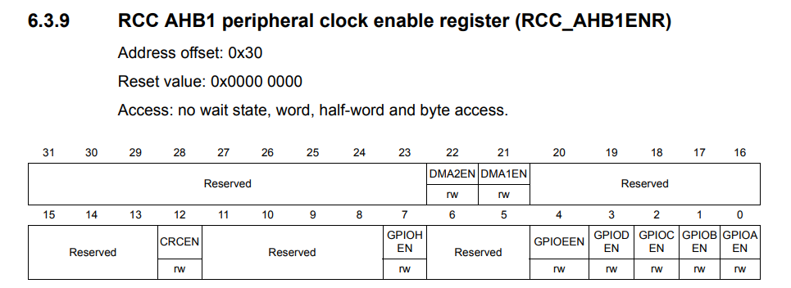
Enabling Clock
RCC->AHB1ENR = 0X00000001;
Let us use GPIOA for all the operations.

Slide 6
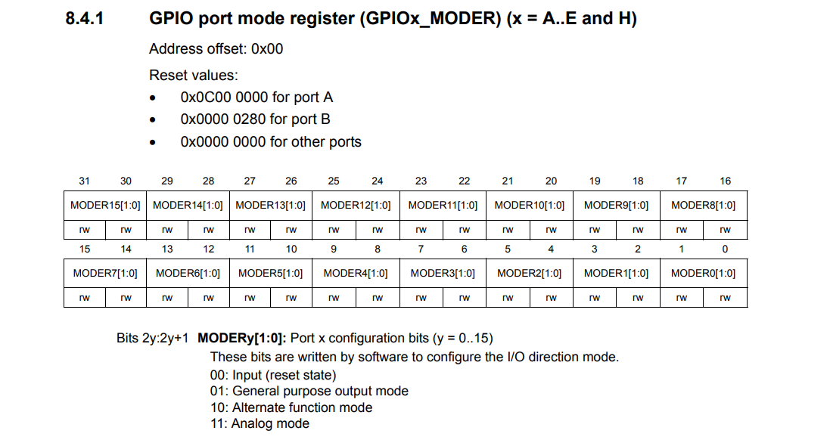

Slide 7
How to Write a value into a register?
GPIOA->MODER = 0X00000001; //which means PA.0 is output
Now if I want PA.3 to be as output then
GPIOA->MODER = 0X00000040;
This will configure PA.3 as output but remove the previous configuration of PA.0.
Instead we can use “&=~” combination read as “and assigned with negation of” to reset necessary ports.
We can use “|=“ combination read as “or assigned with” to configure to required mode.

Slide 8
How to Write a value into a register?
Objective: make PA.0 to PA.6 as outputs, PA.8 as input.
Steps:
Reset the MODER register of port A pertaining to PA.0 to PA.6 and PA.8.
A moder state of “00” for a particular pin is assumed to be the reset state.
GPIOA->MODER&=~0X00033FFF;
Configure the MODER register of port A for PA.0 as o/p and PA.1 as i/p
“01” for a pin is treated as output.
“00” for a pin is treated as input.
GPIOA->MODER |= 0X00001555;

Slide 9
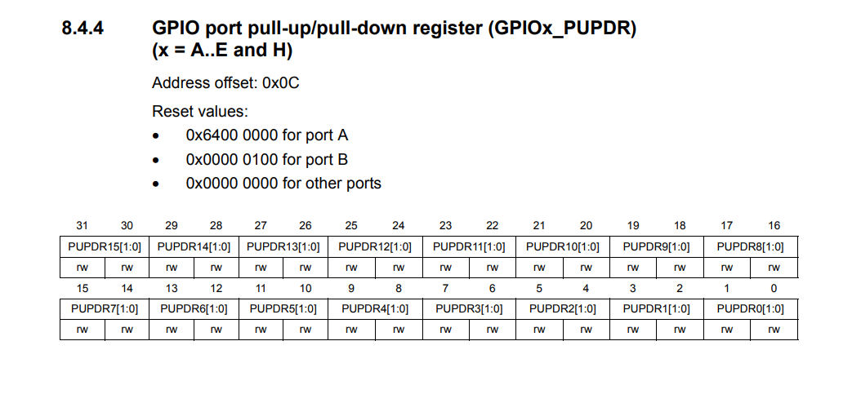

Slide 10
Configuring pull up and pull down registers
Why should I configure PUPDR?
When I don’t press the switch, the default value of the switch is depended on whether the pin is pulled up or pulled down.
What are the default values?
Pulled up pin: Default value is “0”.
Pulled down pin: Default value is “1”.
“00” is for No pull up No pull down
“01” is for Pull-Up
“10” is for Pull-Down
“11” is Reserved
Reset PUPDR
GPIOA->PUPDR&=~0x00030000;
Configure PUPDR
GPIOA->PUPDR|=0X00010000
Let us assume “count = 0”

Slide 11
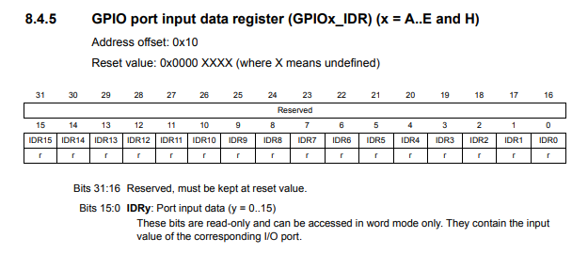
Monitoring IDR
Read data from IDR
First construct the monitoring bit, here IDR1 must be 1 to monitor the state of IDR1 we have to perform bitwise and with IDR register
GPIOA->IDR & 0X00000100; This will read the status of the particular pin through IDR

Slide 12
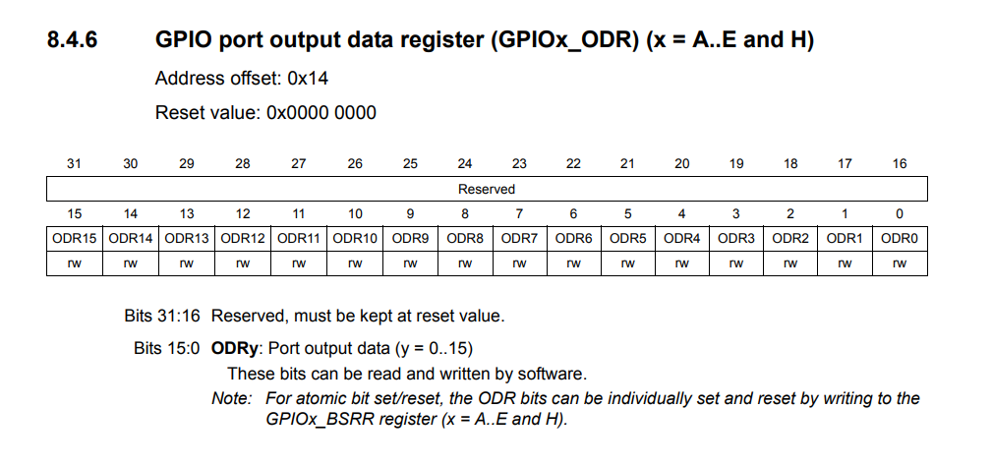
Configuring ODR
Initialize an array with the digit wise hex codes.
num[10]={0X3F,0X06,0X5B,0X4F,0X66,0X6D,0X7D,0X07,0X7F,0X6F};
Increment the count if status of the pin is changed, don’t increment while pressed, increment only when released.
Now configure the ODR by the necessary hex code.
GPIOA->ODR=num[count%10];

Slide 13
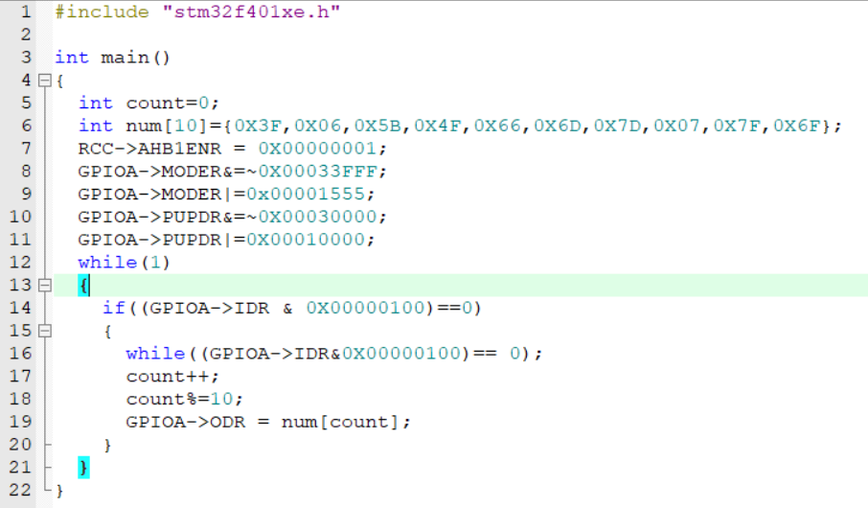
Final Code

Slide 14

Please Subscribe to my channel……..
Like Share Comment Subscribe

